Slide 1


CIS 5570- Introduction to Big Data
FINDING FREQUENT SETS OF SYMPTOMS & PREDICTION OF HEART DISEASE
Presented by-
Pratiksha Gaikwad
Fariha Danish
Sayali Gaurav Agalave
Anika Raisa Chowdhury
Anubhuti Hiwase

Slide 2
Goal
Research goal: Predicting Heart Disease Risk using Efficient Frequent Itemsets
Dataset: https://www.kaggle.com/datasets/johnsmith88/heart-disease-dataset
The original data set consists of four databases: Cleveland, Hungary, Switzerland, and Long Beach V. It contains 76 attributes.
For our analysis we are considering just the Cleveland database having 13 attributes.

Slide 3
Introduction
Heart is an important part of the body. And also Heart diseases are the one of the leading human killer diseases.
In today’s world, the cause of death for both men and women is primarily by heart disease.
Data mining is widely used in many domains. It plays an vital role in the medical domain.
The idea of discovering patterns which may aid in decision making and saving of lives. We decided to work with the Apriori algorithm.
For predicting the frequent itemsets(symptoms) our dataset and create the association rules that indicate risk of heart disease.
We have trained the binary classification model to predict the presence or absence of heart disease.

Slide 4
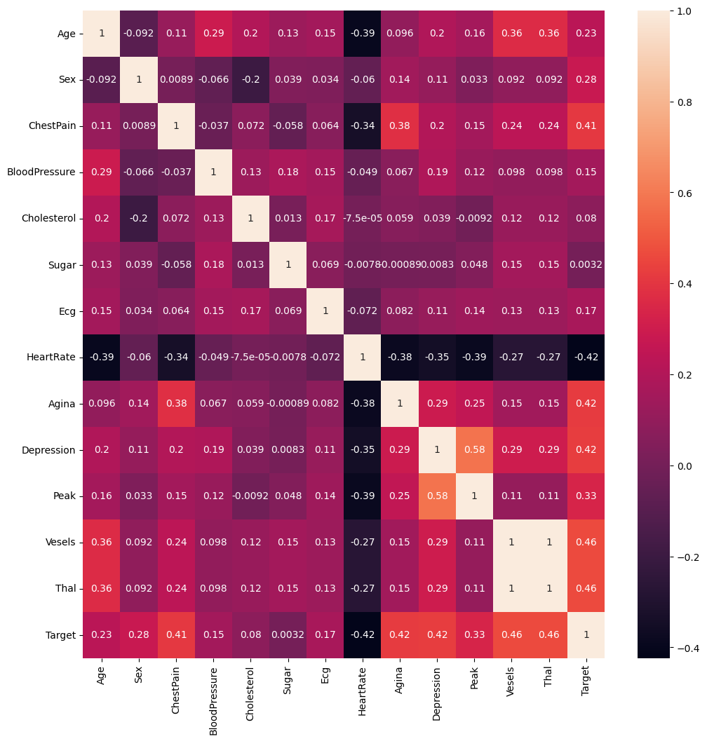
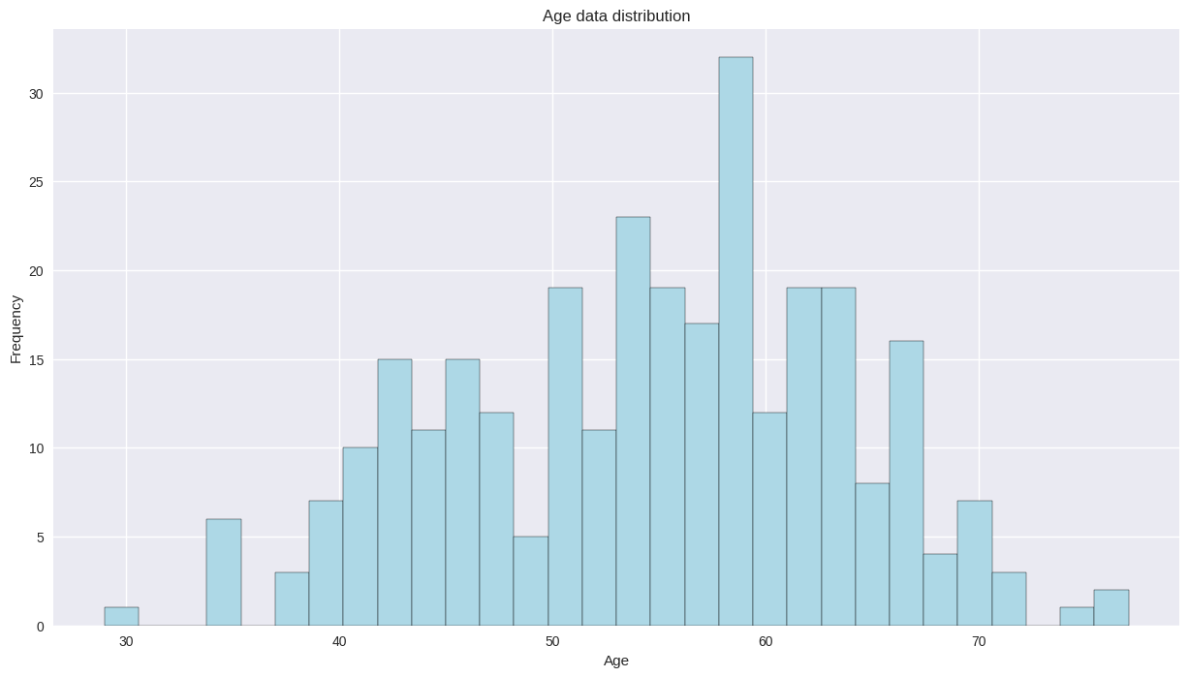
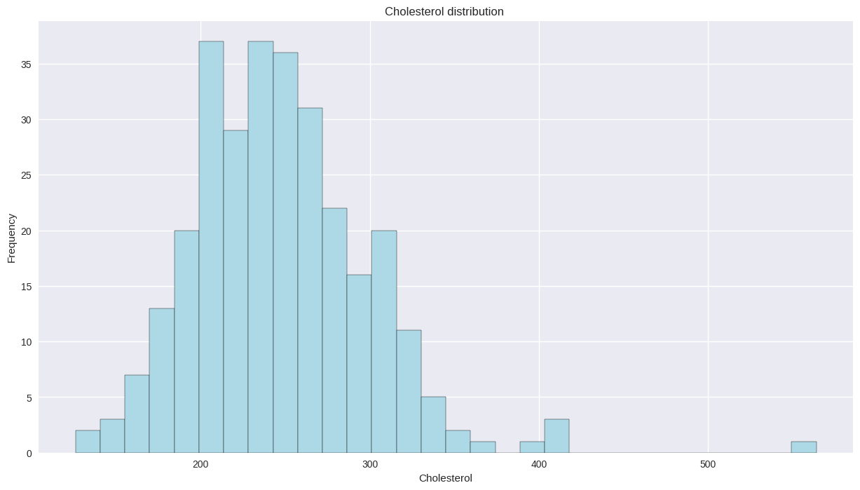
Preprocessing Data
Data cleaning & manipulation
Zeroing in on cleveland data

Slide 5
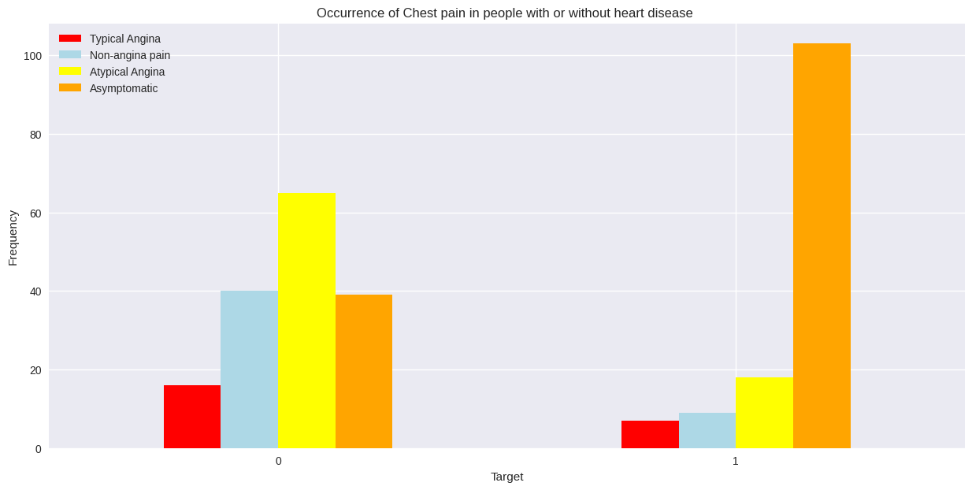

Slide 6
Methodology
We first found the frequency of singletons.
Using the map and reduceByKey transformations, we determined the frequency .
We applied the filter transformation to the RDD where the lambda function checks if the first value in the combination is greater than or equal to 2.
This step includes the extraction of the key-value pairs from the combination of all 4 attributes using map and collectAsMap functions.
Extracts the age, gender, angina_count, sugar_count and calculates the support for the current age & gender combination
In next step, the confidence of angina & sugar is obtained using the calculated counts & support for the age-gender group

Slide 7
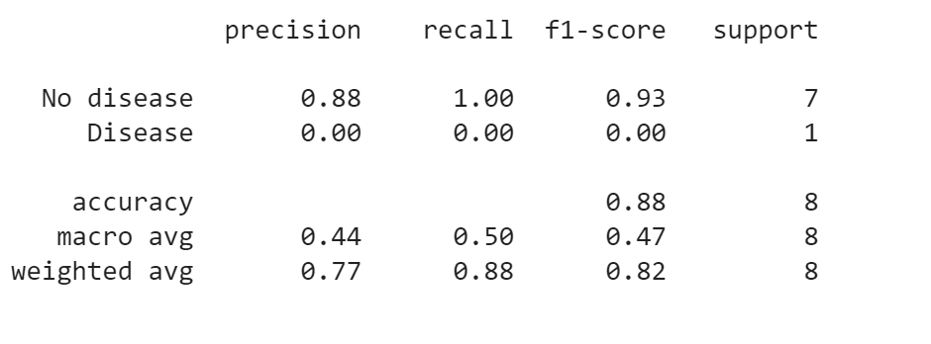
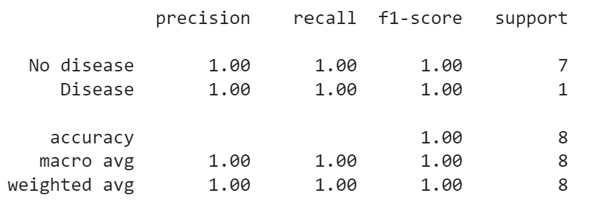
Classification and Prediction
KNN
Feature extraction
Classification Methods
KNN Algorithm => AUC score: 0.75, ROC AUC score => 0.67
Decision Trees => AUC score: 1, ROC AUC score => 1
Model evaluation:
a. Precision, Recall, F1 score
b. Confusion matrix
Decision tree

Slide 8
Conclusion
The results of this project demonstrate the potential of data mining techniques like Apriori for improving the accuracy and efficiency of heart disease prediction.
Future research in this area could explore the use of other data mining algorithms and machine learning techniques for developing more sophisticated and accurate heart disease prediction models.
Additionally, expanding the dataset to include more patient data and a wider range of symptom variables could provide further insights into the risk factors associated with heart disease and improve the accuracy of the prediction models.

Slide 9
References
[1] R. Das, I. Turkoglu, and A. Sengur, “Diagnosis of valvular heart disease through neural networks ensembles,” Elsevier, 2009.
[2] M. Karaolis, J. A. Moutiris, and C. S. Pattichis, “Association rule analysis for the assessment of the risk of coronary heart events,” Proceedings of the 31st Annual International Conference of the IEEE Engineering in Medicine and Biology Society, 2009.
[3] A. K. Pandey, P. Pandey, K. L. Jaiswal, and A. K. Sen, “Data Mining Clustering Techniques in the Prediction of Heart Disease using Attribute Selection Method,” International Journal of Science, Engineering and Technology Research (IJSETR), ISSN: 2277798, Vol 2, Issue10, October 2013
[4] https://archive.ics.uci.edu/ml/datasets/Heart+Disease
[5] https://www.ncbi.nlm.nih.gov/pmc/articles/PMC8266441/

Slide 10
Thank You !!

